Slide 1




Waste streams and waste management cycles - Innovative Methods of Waste Management and Recycling
BEBB – Decentralised Training, Sofia, 01.10.2013
Dr. Jochen Zeiger, Magdeburg CCI
LOGO HERE

Slide 2



Waste streams and waste management cycles| Sofia, 01.10.2013 | Page 2
Waste streams and waste management cycles - Innovative methods of waste management and recycling
1. Introduction
2. Worst case – using the example of treatment of electrical scrap in Africa
3. Best recycling techniques - waste management cycles designed according to availability of resources using the example of treatment of sewage sludge
4. Best recycling techniques - waste management cycles designed according to solving recovery problems using the example of treatment of household waste

Slide 3
Waste streams and waste management cycles| Sofia, 01.10.2013 | Page 3
Introduction
1.1 Waste Framework Directive 2008/98/EC – basis of all waste treatment activities
Prevention
Preparing for re-use
Recycling
Other recovery, e.g. energy recovery
Disposal
Article 4 – Definition of waste hierarchy, shall apply as a priority
order in waste prevention and management legislation and
Policy.

Slide 4
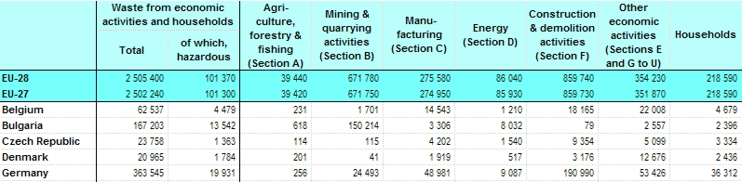
Waste streams and waste management cycles| Sofia, 01.10.2013 | Page 4
1.2 Current waste statistics of EU-28
(Eurostat July 2013, Data base 2010)

Slide 5
Waste streams and waste management cycles| Sofia, 01.10.2013 | Page 5
Total quantity: 386 mio. t
Recycling rate: 77,6 %
Disposal rate: 17,5 %

Slide 6
Waste streams and waste management cycles| Sofia, 01.10.2013 | Page 6
1.4 Target course of presentation
Construction and demolition waste - biggest mass waste, because of a low level of environmental hazard and a high recycling rate not in the focus of the presentation,
Mining waste – in the responsibility of mining companies, if possible using waste for restoration on a high rate, not in the focus of presentation,
Process waste - in the responsibility of manufacturers, because of many different sorts of waste and treatment technologies not possible to give a overview in this presentation,
Secondary waste – in the focus of presentation, using the example of treatment of sewage sludge,
Municipal waste – in the focus of presentation, because municipal waste has a highly different consistence and therefore difficulty to design a full recovery.

Slide 7
Waste streams and waste management cycles| Sofia, 01.10.2013 | Page 7
2. Worst case – using the example of treatment of used electrical devices/scrap in Africa
2.1 Legal opinion
Export of electrical devices/scrap from EU to African countries under European law (Regulation 05118931649No. 1013/2006 on shipment of waste),
After Regulation No. 1013/2006 allowance to export electrical devices, if they are working,
approx. 25 % of all current shipment to Africa (and Asia) is declared as “functioning product” but contains no functioning devices or scrap and thus means a violation of international regulations,
Actually an amendment of Regulation No. 1013/2006 is in progress to increase the requirements for delivery of used electrical devices outside the EU,

Slide 8
Waste streams and waste management cycles| Sofia, 01.10.2013 | Page 8
2.2 Situation in Africa – Using example Ghana
Export of 155.000 tons of used electronic products/scrap from Germany to Africa or Asia,
Ghana is a hot spot,
Extensive realisation of EU-Regulation related to treatment of used electronic products/scrap would lead to serious economic damages in Ghana - why?,
in Ghana as well as in other Eastern African countries exist a very strange commercial practice: Selling of used electronic products happens without a functional check (sale as seen) at a very low price,
Importer is only bearing a small risk, has only to cover the costs of transportation and storage and realizes comfortable margin in spite of small price,

Slide 9
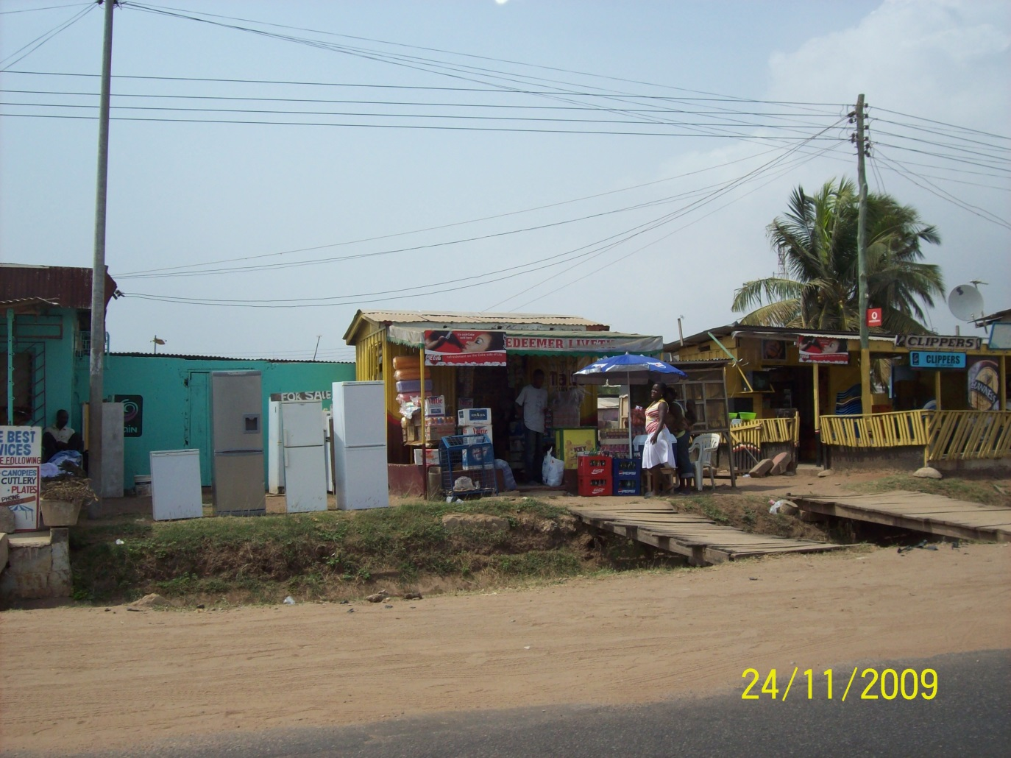
Waste streams and waste management cycles| Sofia, 01.10.2013 | Page 9
Street sale
in Accra,
Capital of Ghana

Slide 10
Waste streams and waste management cycles| Sofia, 01.10.2013 | Page 10
2.3 Market for repairing and recycling of used electrical devices in Ghana
For customer very favorable conditions, if device works,
If not, usage of one of the thousands of competent workshops,
approx. 24,000 people repair electrical devices in Ghana, thereof 15,000 in the capital Accra,
If repairing successful, it is still a favorable deal for buyer,
If repairing not successful, electrical devices will be sold with loss to a salvager,
approx. 6,000 people are collecting and recycling electrical scrap in Accra,

Slide 11
Waste streams and waste management cycles| Sofia, 01.10.2013 | Page 11
Income structure of the market for repairing and recycling of used electrical devices:
  average earnings in Ghana approx. 600 €/year,
  average earnings of owner of a workshop max. 450 €/month,
  average earnings of a craftsman max. 200 €/month,
  average earnings of a salvager or recycling worker on a landfill max. 100 €/month.

Slide 12
Waste streams and waste management cycles| Sofia, 01.10.2013 | Page 12
Situation of recycling of electrical scrap
  One of the environmentally most hazardous places in the world of recycling electrical scrap: landfill and disposal area Agbogbloshie Accra,
  Agbogbloshie is an approx. 5 square kilometers large suburb with simple residential areas, a large market and a commercial zone. Disposal area lies on the edge of the suburb and has a size of 0,2 square kilometers.
  Throughput of approx. 13,000 tons of electrical waste per year,
  immense environmental and health damage caused by soldering lead, dioxins, furans, CFC, phosphorus and heavy metals,
  Life expectancy of the people working at the landfill, thereof many children and young people, is about 10 years from the start of the activity.

Slide 13
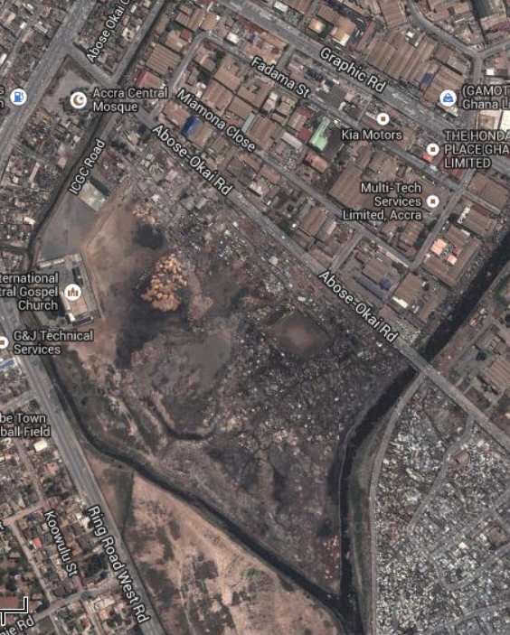
Waste streams and waste management cycles| Sofia, 01.10.2013 | Page 13
Impressions of Agbogbloshie

Slide 14
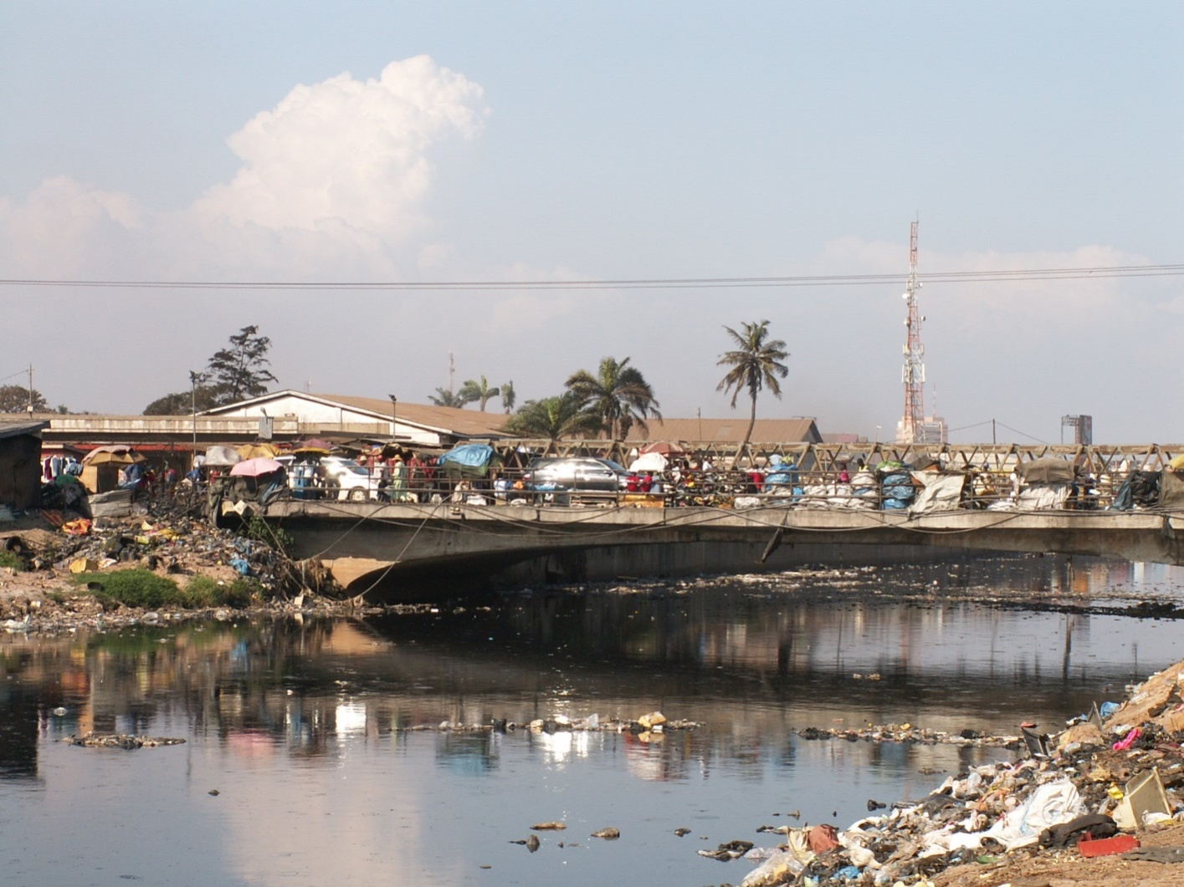
Waste streams and waste management cycles| Sofia, 01.10.2013 | Page 14

Slide 15
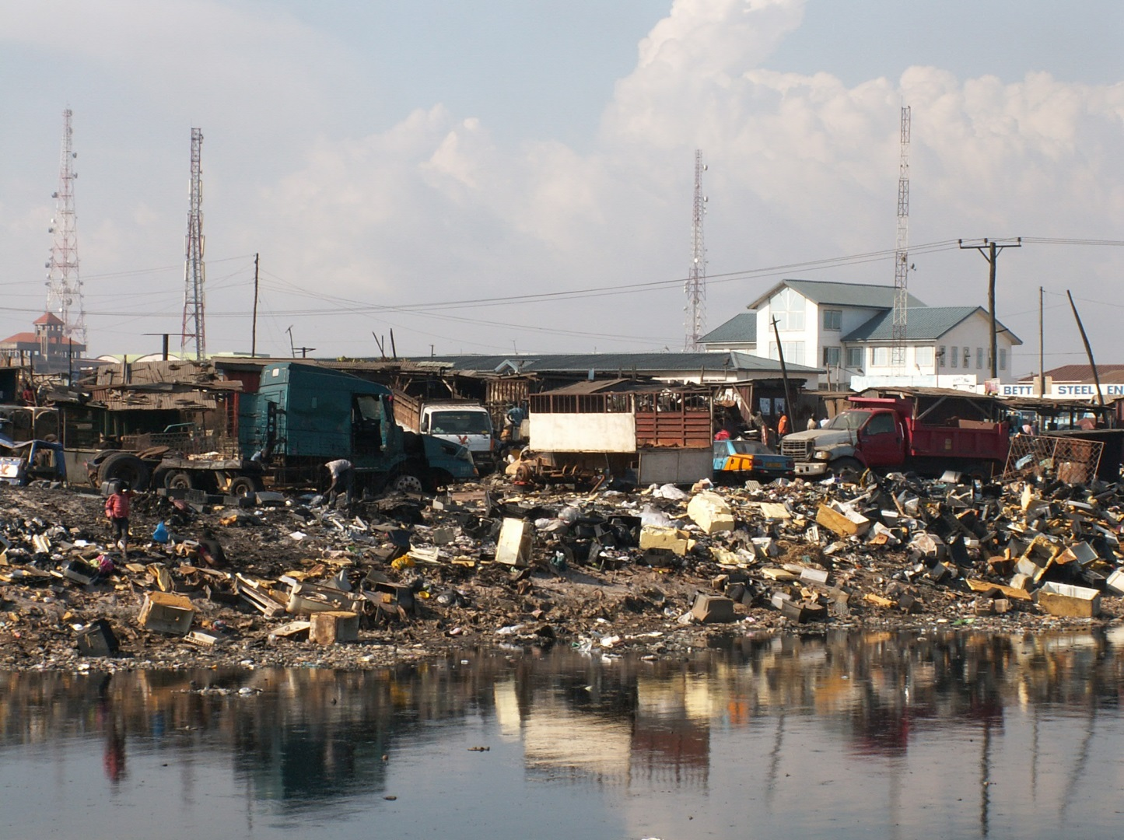
Waste streams and waste management cycles| Sofia, 01.10.2013 | Page 15

Slide 16
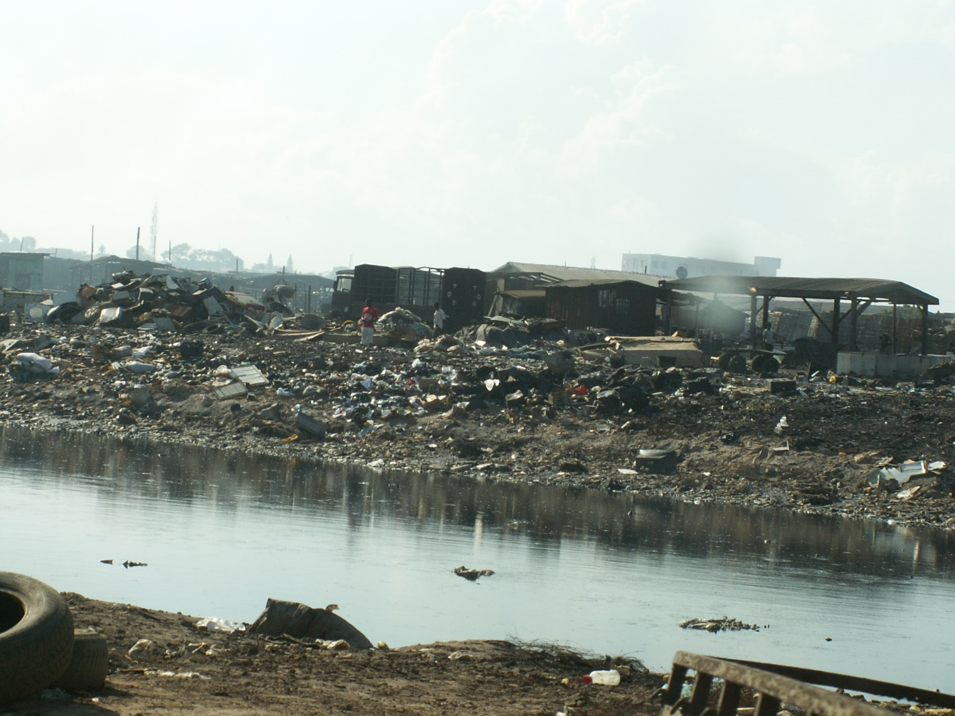
Waste streams and waste management cycles| Sofia, 01.10.2013 | Page 16

Slide 17
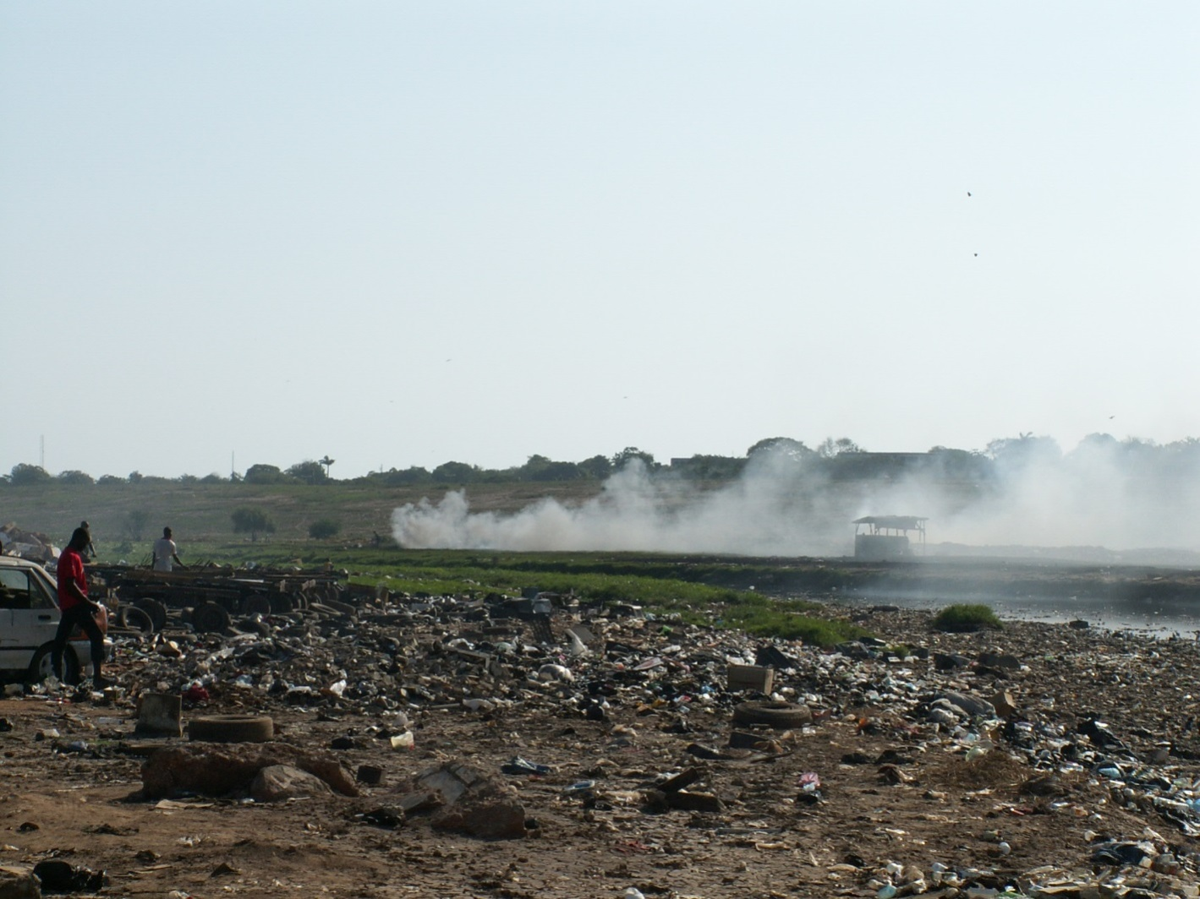
Waste streams and waste management cycles| Sofia, 01.10.2013 | Page 17

Slide 18
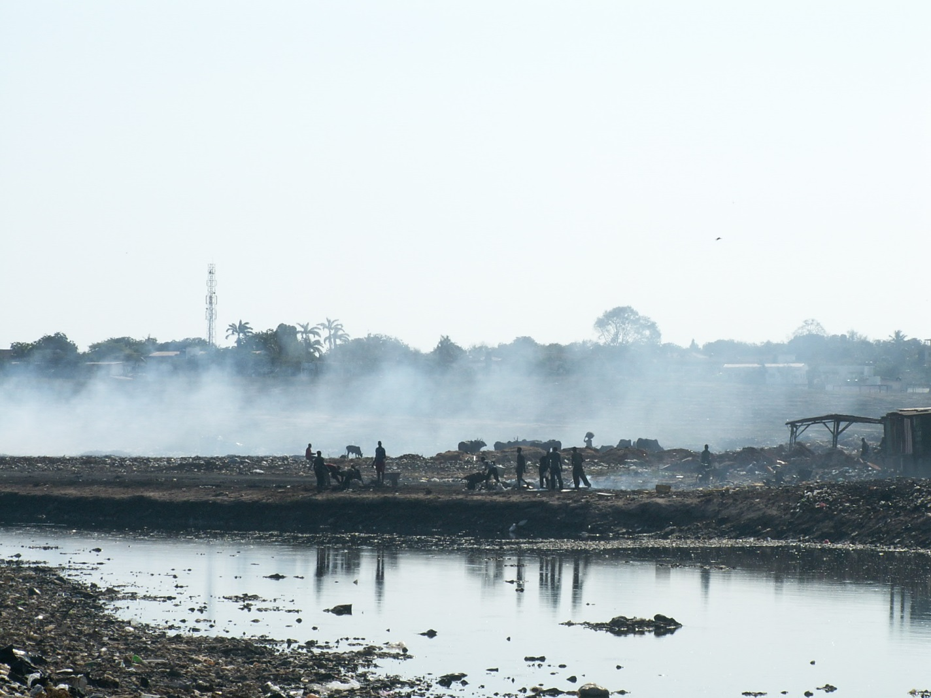
Waste streams and waste management cycles| Sofia, 01.10.2013 | Page 18

Slide 19
Waste streams and waste management cycles| Sofia, 01.10.2013 | Page 19
2.4 Outlook
For Ghana it would be best, to conserve the import of used electrical devices (functional and nonfunctional) from developed countries,
assist developing countries in the disposal/recovery of the remaining electrical waste.
Project approaches have failed so far because mainly children and young people work on the landfill who are not capable of being integrated in projects with German companies for reasons of child protection,
Demand of Ghanain authorities to covering the costs of professional training for children and young people by German companies – in view of the whole costs unrealizable.

Slide 20
Waste streams and waste management cycles| Sofia, 01.10.2013 | Page 20
3. Best recycling techniques - waste management cycles designed after availability of resources using the example of treatment sewage sludge

Slide 21
Waste streams and waste management cycles| Sofia, 01.10.2013 | Page 21
3.1 Background
In Compliance with the German Sewage Sludge Ordinance it is allowed to bring sewage sludge up to fields,
Cheapest way, but causes significant efforts:
  Analysis of the sewage sludge,
  Analysis of the Soil,
  Provide evidence and register,
  Create plans for bringing up sewage sludge.

Slide 22
Waste streams and waste management cycles| Sofia, 01.10.2013 | Page 22
Prohibited to bring up sewage sludge to
  Fruit- and vegetables fields,
  Greenland,
  Forest,
  Fields in nature protection areas,
  Fields in water protection areas and
  If level of pollutants higher than the limit in the Sewage Sludge Ordinance.
Intention of policy for the future is to prohibit the bringing up of sewage sludge to fields like in Switzerland (German federal states in the South and West are for prohibiting and the states in the North and East against),

Slide 23
Waste streams and waste management cycles| Sofia, 01.10.2013 | Page 23
3.2 Actual situation of natural rock phosphate
Approx. 240,000 – 260,000 t/year import of rock phosphate to Germany per ship mainly from Morocco (approx. 80 %) and Israel,
Per capita rate of phosphor in sewage in Germany approx. 2.5 kg/year,
In case of mineralization of the entire sewage sludge in Germany for recovery of phosphor would be approx. 200,000 t phosphate available,
Worldwide statistic remaining sources of rock phosphate approx. 300 years.

Slide 24
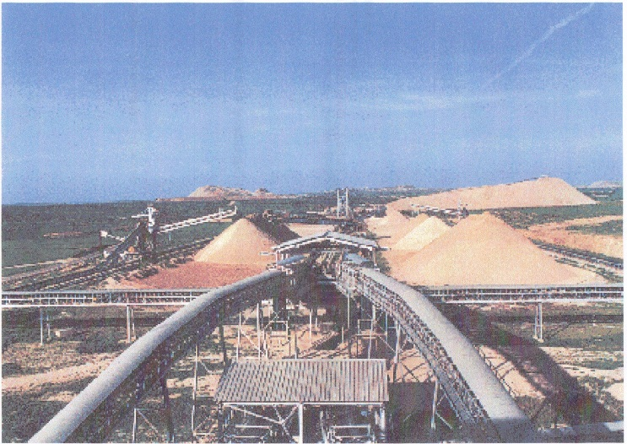
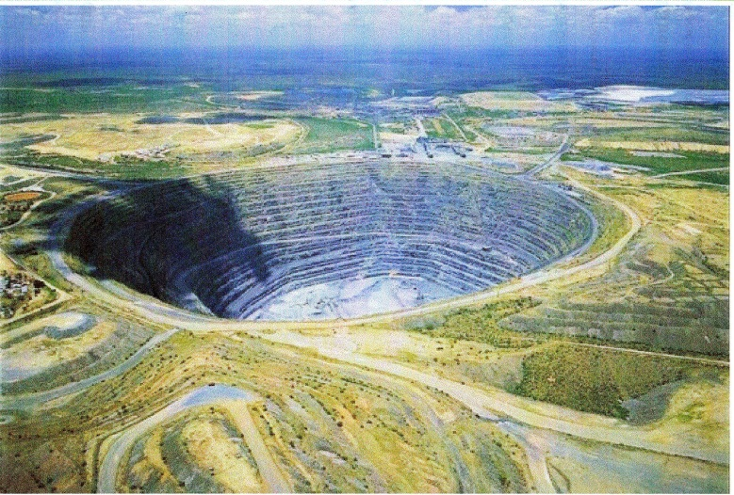
Waste streams and waste management cycles| Sofia, 01.10.2013 | Page 24
Morocco
South Africa

Slide 25
Waste streams and waste management cycles| Sofia, 01.10.2013 | Page 25
3.3 Producing of phosphor fertilizer
Superphosphate: chemical extraction of rock phosphate (insoluble calcium phosphate) with sulfuric acid react to soluble calcium dihydrogenphosphate (approx. 16 – 22 per cent by weight P₂O₅),
Ca₃(PO₄)₂ + 2 H₂SO₄ + 2 H₂O → Ca(H₂PO₄)₂ + 2 CaSO₄ * 2 H₂O
Double superphosphate: chemical extraction of rock phosphate with normal technical phosphoric acid react also to soluble calcium dihydrogenphosphate (approx. 35 per cent by weight P₂O₅),
Ca₃(PO₄)₂ + 4 H₃PO₄ → 3 Ca(H₂PO₄)₂
Triple superphosphate: chemical extraction of rock phosphate with phosphoric acid in higher quality react to approx. 46 per cent by weight P₂O₅,
Ca₃(PO₄)₂ + 4 H₃PO₄ → 3 Ca(H₂PO₄)₂
Recophos-Fertilizer: chemical treatment of sewage sludge ash with phosphoric acid und approx. 38 per cent by weight P₂O_{5.}

Slide 26
Waste streams and waste management cycles| Sofia, 01.10.2013 | Page 26
3.4 Current situation of sewage sludge
Sewage sludge volume in Germany per annum:
10 mio. t, (approx. 25% dry substance and 75% water), thereof approx. 50 % in agricultural recovery and the other 50 % to incineration (650,000 t in sewage sludge mono-incineration, rest goes to municipal waste incineration plants, coal-fired power plants or cement mills,
Sewage sludge volume in Saxony-Anhalt per annum:
240,000 t, thereof 25% dry substance,
Proportion of sewage sludge to ash:
9 t sewage sludge result in 1 t ash (consistence similar apatite [raw phosphate]),

Slide 27
Waste streams and waste management cycles| Sofia, 01.10.2013 | Page 27
Potential of sewage sludge ash:
total amount of approx. 1.2 mio. t with following components (approx.):
  240,000 t phosphate
  150,000 t iron
  85,000 t aluminium
  35,000 t magnesium
  1,200 t thallium
  1,300 t germanium.

Slide 28
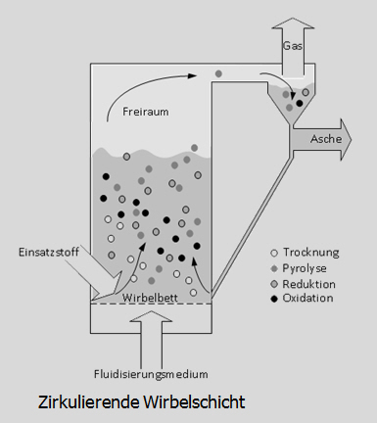
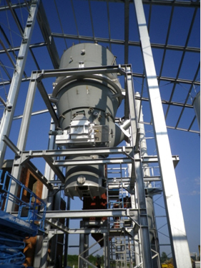
Waste streams and waste management cycles| Sofia, 01.10.2013 | Page 28
3.5 RecoPhos-Process - Full-scale recovery of phosphate from sewage sludge ash
Circulating fluidized bed
Fluidized bed apparatus

Slide 29
Waste streams and waste management cycles| Sofia, 01.10.2013 | Page 29
RecoPhos flow sheet

Slide 30
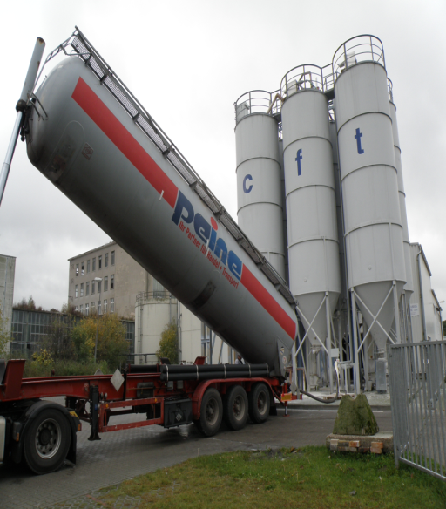
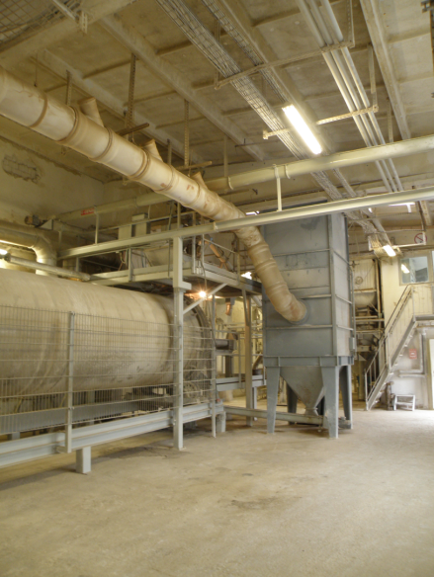
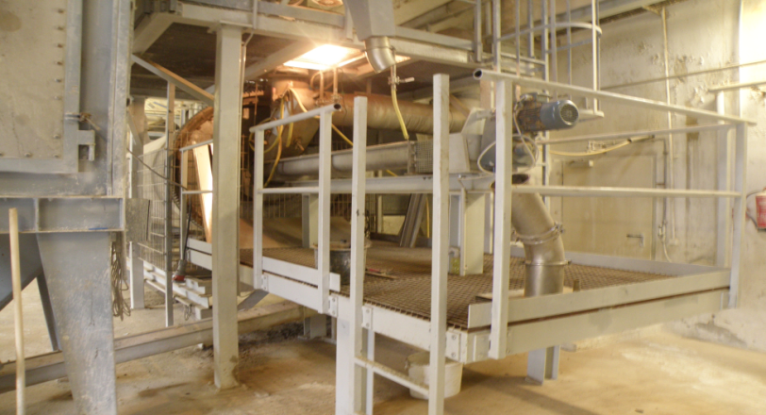
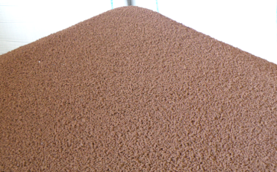
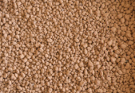
Waste streams and waste management cycles| Sofia, 01.10.2013 | Page 30
Delivery/Off-Loading Ash Drying Granulation
Conditioning

Slide 31
Waste streams and waste management cycles| Sofia, 01.10.2013 | Page 31
3.6 Comparison data RecoPhos-Fertilizer with limits of German Fertilizer Application Ordinance (DüMV) 2008
Element | Limit mg/kg_{DS} | Data RecoPhos mg/kg_{DS}
Arsenic | 40 | 9,1
Plumb | 150 | 51,4
Cadmium | 50 | 2,2
Chrom (total) | 300 | 118
Chrom (VI) | 2,0 | < 0,01
Nickel | 80 | 47,4
Mercury | 1,0 | 0,7
Thallium | 1,0 | 0,2
Perfluorocarbon | 0,1 | < 0,01

Slide 32
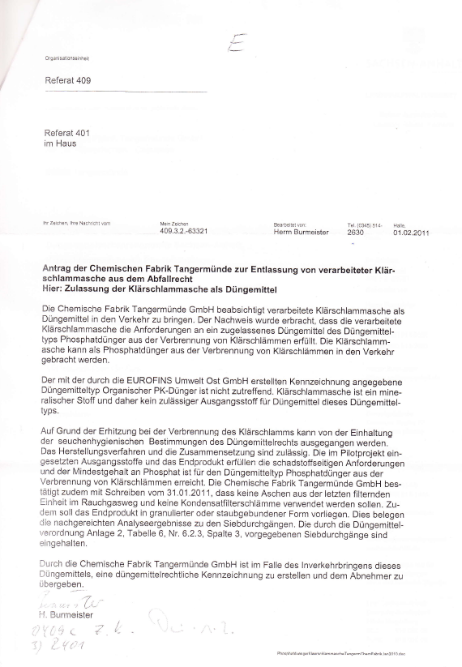
Waste streams and waste management cycles| Sofia, 01.10.2013 | Page 32
3.7 End-of-waste criteria after Article 6 of the EU-Waste Framework Directive
RecoPhos fertilizer meets the end-of-waste criteria specified in Article 6 of the EU-Waste Framework Directive,
Environmental administration of Saxony-Anhalt dismissed RecoPhos-fertilizer from waste legistlation regime.

Slide 33
Waste streams and waste management cycles| Sofia, 01.10.2013 | Page 33
3.8 Comparison pollutant content of sewage sludge ash and natural rock phosphate

Slide 34
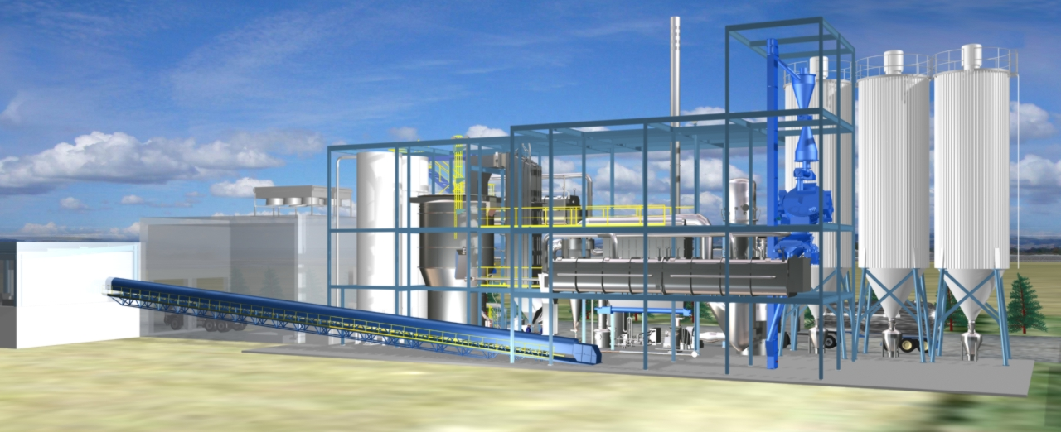
Waste streams and waste management cycles| Sofia, 01.10.2013 | Page 34
3.9 Concept of a RecoPhos plant (Monoincineration of sewage sludge and production of superphos-phate fertilizer)

Slide 35
Waste streams and waste management cycles| Sofia, 01.10.2013 | Page 35
3.10 Business conditions
Operational capacity incineration module: 35,000 t/year sewage sludge to approx. 4,000 t ash,
Operational capacity fertilizer module: 30,000 t Triple superphosphate fertilizer/year
ash potential in Saxony-Anhalt approx. ca. 15,000 t/a,
Supply of ash from some of the 19 mono incineration plants in Germany are necessary,
current price for incineration of sewage sludge and landfill: 50 €/ton,

Slide 36
Waste streams and waste management cycles| Sofia, 01.10.2013 | Page 36
Economic feasibility of RecoPhos-Process depends on
  Upcoming modification of German Sewage Sludge Ordinance (to increase the requirements for bringing up to fields, prohibition of bringing up like in Switzerland not impossible),
  Upcoming of a new German Phosphor Recovery Ordinance for waste with more than 5 % phosphor content,
  Price trend for phosphor,
Optimizing of cost in the future by developing und using SeraPhos-process (own producing of phosphor acid from sewage sludge ash of industrial sewage plants,
Overall costs of a combined monoincineration plant and fertilizer plant: approx. 19 Mio. €.

Slide 37
Waste streams and waste management cycles| Sofia, 01.10.2013 | Page 37
4. Best recycling techniques - waste management cycles designed after solving recovery problems using the example of treatment household waste

Slide 38
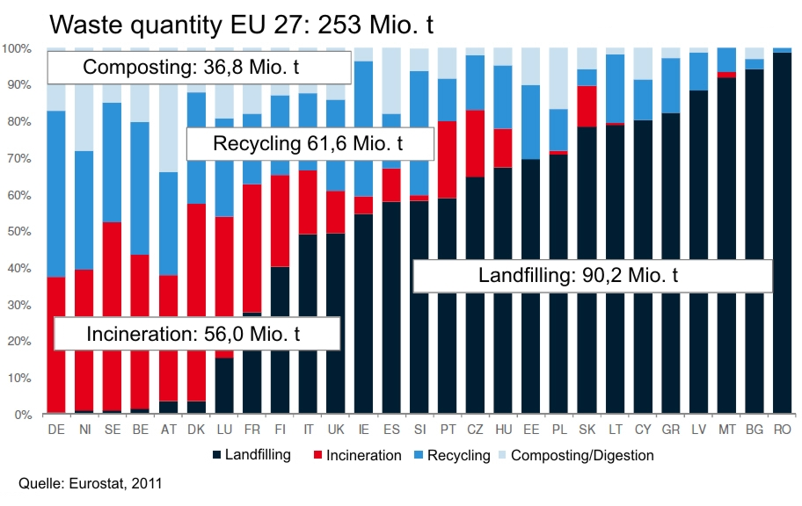
Waste streams and waste management cycles| Sofia, 01.10.2013 | Page 38
4.1 Treatment of municipal waste in the EU 2011

Slide 39
Waste streams and waste management cycles| Sofia, 01.10.2013 | Page 39
4.2 Separation municipal waste in Germany
Packaging materials (e.g. Beverage cartons, Cans, Cotton bags and nets, Medicine blister-packs, Menu trays for ready-to-eat meals, Paint buckets (plastic or tinplate), Polystyrene packages [e.g. for electrical equipment), Shampoo bottles (plastic), Spray cans, Stoneware bottles, Wooden boxes, Yoghurt tubs and tops,
Specified products (e.g. Electrical and electronical devices, Batteries)
Glass
Paper and cardboard
Bio-waste
Hazardous waste and
Residual waste

Slide 40
Waste streams and waste management cycles| Sofia, 01.10.2013 | Page 40
4.3 Prohibition of disposal of municipal waste
Approx. 37 mio. tons/year municipal waste in Germany,
Disposal of municipal waste pollutes the soil and ground water,
Therefore in Germany the disposal of untreated waste in landfills is prohibited since 1. June 2005 (Directive Technical Instructions for the Disposal of Municipal Waste, TASI, released in 1993),
Criteria is glowing residue of max. 5 % for landfilling (glowing the waste in a muffle furnace at 550 °C, so long, until mass reducing stops),

Slide 41
Waste streams and waste management cycles| Sofia, 01.10.2013 | Page 41
4.5 Waste incineration in Saxony-Anhalt, Germany
Operators and capacity of waste incineration plants in Saxony-Anhalt (09.07.2013)
MHKW Magdeburg-Rothensee (municipal waste) 630 Tt/year
TREA Leuna (municipal and industrial waste) 390 Tt/year
Sita Zorbau b. Weißenfels (municipal waste) 300 Tt/year
Remondis Staßfurt (municipal waste) 300 Tt/year
∑ 1,620 Tt/year
================

Slide 42
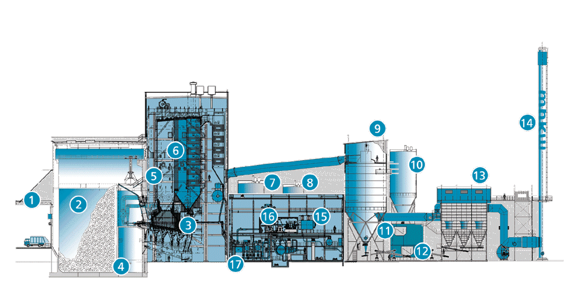
Waste streams and waste management cycles| Sofia, 01.10.2013 | Page 42
4.6 Waste incineration plant Magdeburg
- 2 block with 2 lines (min. 850 °C, 20 tons/hour, 66 MW each line),
- investment of total 250 mio. €,
1 Waste delivery | 2 Bunker | 3 Water cooled grate stoker furnice | 4 Slag bunker | 5 Injection of ammonia water for SNCR I 6 Steam boiler | 7 Hydrated lime silo | 8 Koks silo | 9 Charcoal silo | 10 Spray absorber | 11 White lime silo
12 Lime milk tank | 13 Baghouse filter | 14 Chimney | 15 Generator | 16 Turbine | 17 Heat exchanger for district heating

Slide 43
Waste streams and waste management cycles| Sofia, 01.10.2013 | Page 43
Video „Municipal Waste Incineration
Magdeburg Region“

Slide 44
Waste streams and waste management cycles| Sofia, 01.10.2013 | Page 44
4.7 Slag processing
Processing of untreated raw slags from different waste incinerators with an innovative, patent-protected method (wet preparation),
Processing plant stands for a almost complete recovery of metals and a significant reduction of pollutant levels in the finally processed slags,
Permission to treat 400,000 t slag/year, processing capazity 100 tons/hour,
Preparation follows the successive deliveries, a prior aging is no longer required,
In a first treatment stage unburned materials and coarse scrap iron are separated,
Afterwards the slags are filtered, crushed and again freed from ferrous metals, nonferrous metals and unburned materials.
At the end of the first stage, a slag with residual metals is formed in a stepped grain.

Slide 45
Waste streams and waste management cycles| Sofia, 01.10.2013 | Page 45
Then splitting and cleaning of the grain by means of the patented wet preparation.
Within this washing process, the contaminated fine fraction is separated and dewatered, resulting filter cake is momentary placed on a landfill (inquiries from the industry, for instance from cement industry, for the use of the filter cake exist),
By other ferrous and non-ferrous separators, the still residual metals are separated within the washing process.
The now processed and metal-free mineral grains can be marketed in most areas of the construction industry at the end, due to reduced levels of pollutants.
Thus eliminating waste is reduced, compared with the conventional methods, by up to 75% and thereby supporting the sustainability of the circular economy system.

Slide 46
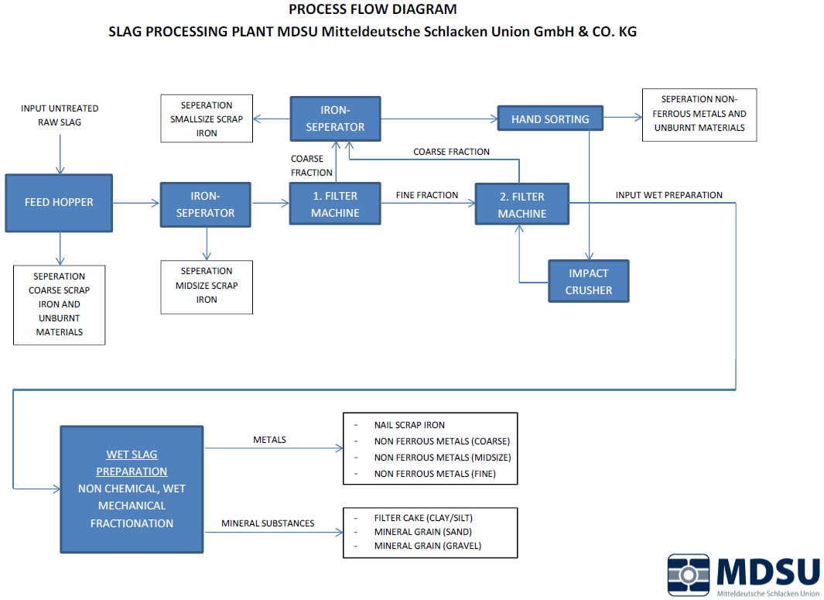
Waste streams and waste management cycles| Sofia, 01.10.2013 | Page 46

Slide 47
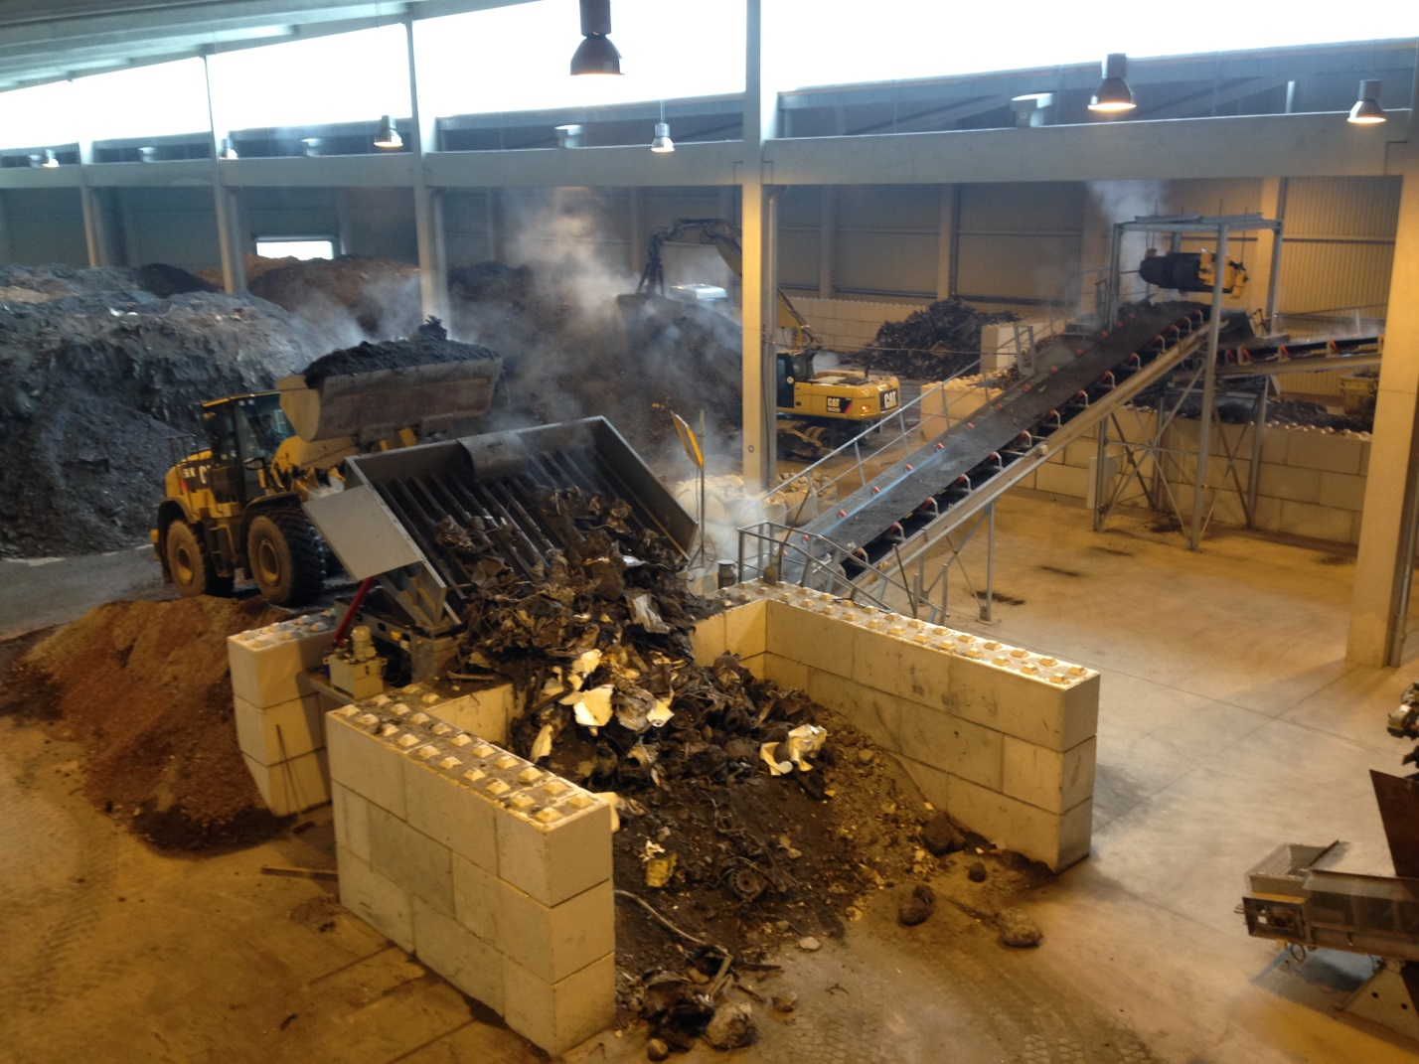
Waste streams and waste management cycles| Sofia, 01.10.2013 | Page 47
Feed hopper
raw slag

Slide 48
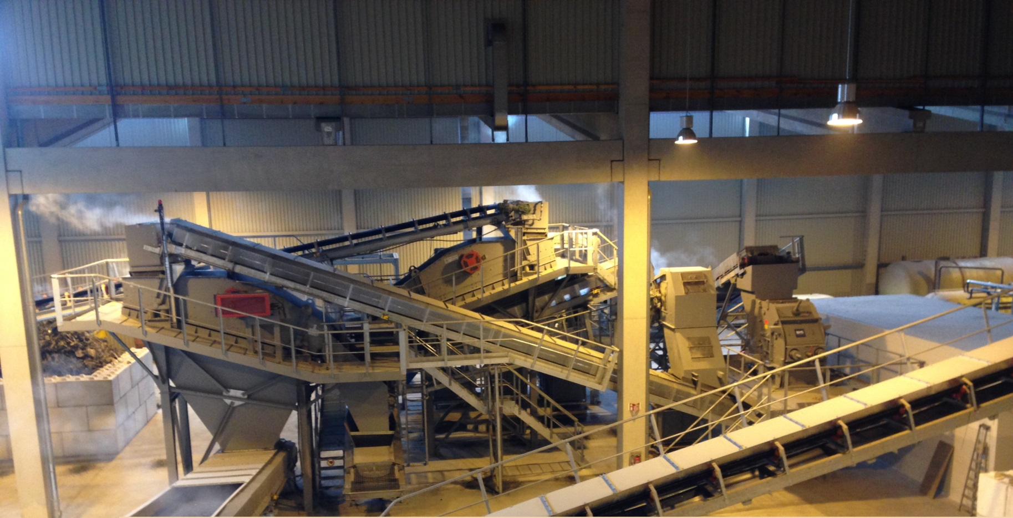
Waste streams and waste management cycles| Sofia, 01.10.2013 | Page 48
Filter impact crusher

Slide 49
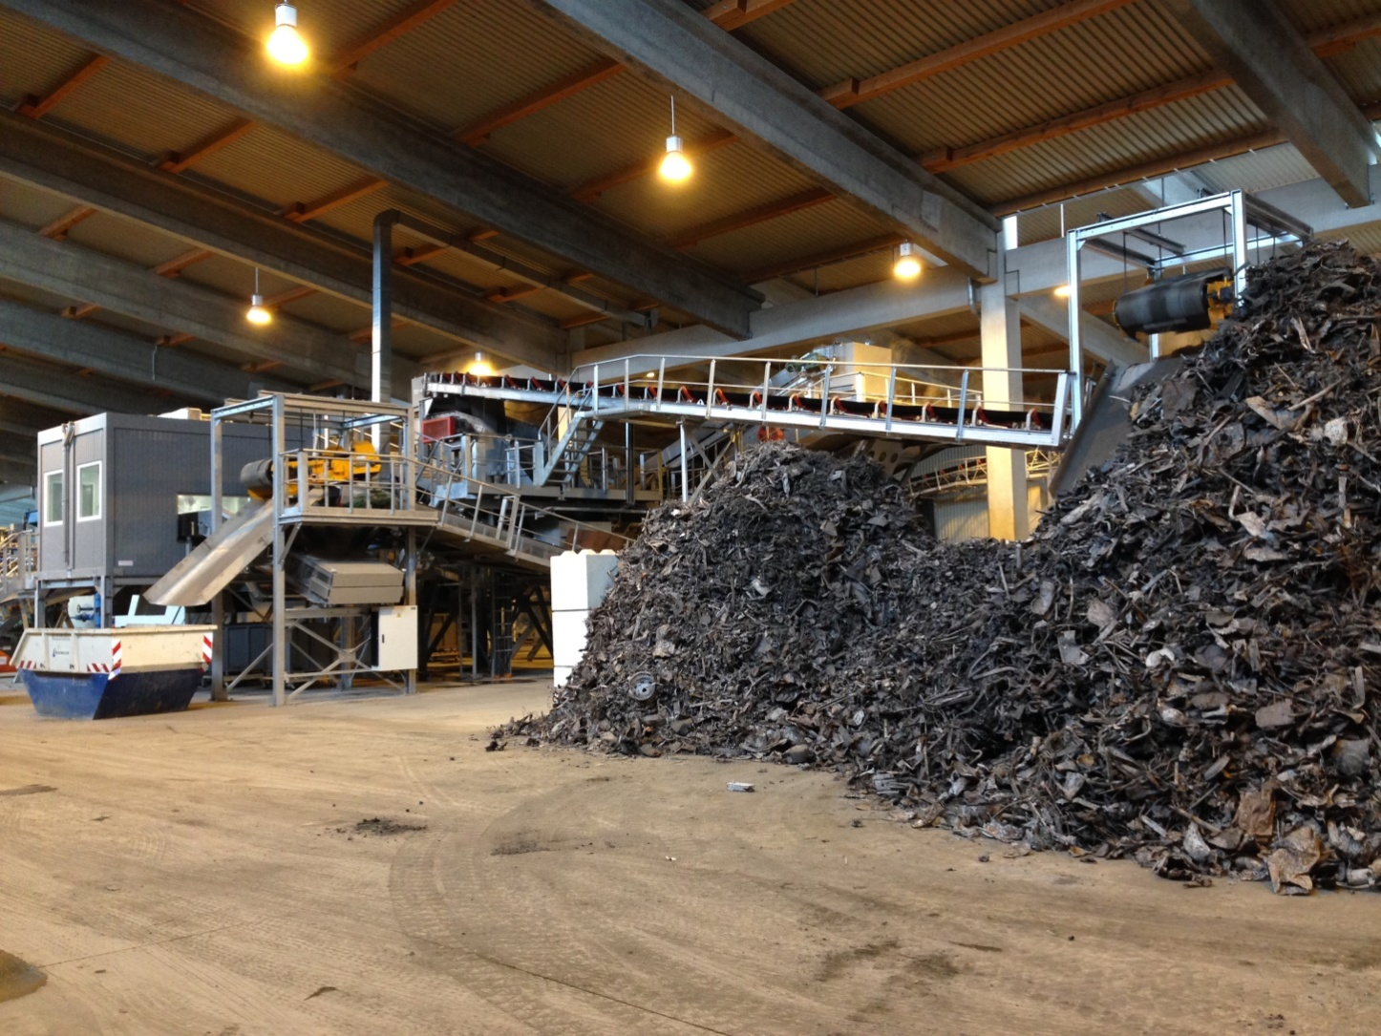
Waste streams and waste management cycles| Sofia, 01.10.2013 | Page 49
Separation
Ferrous metals

Slide 50
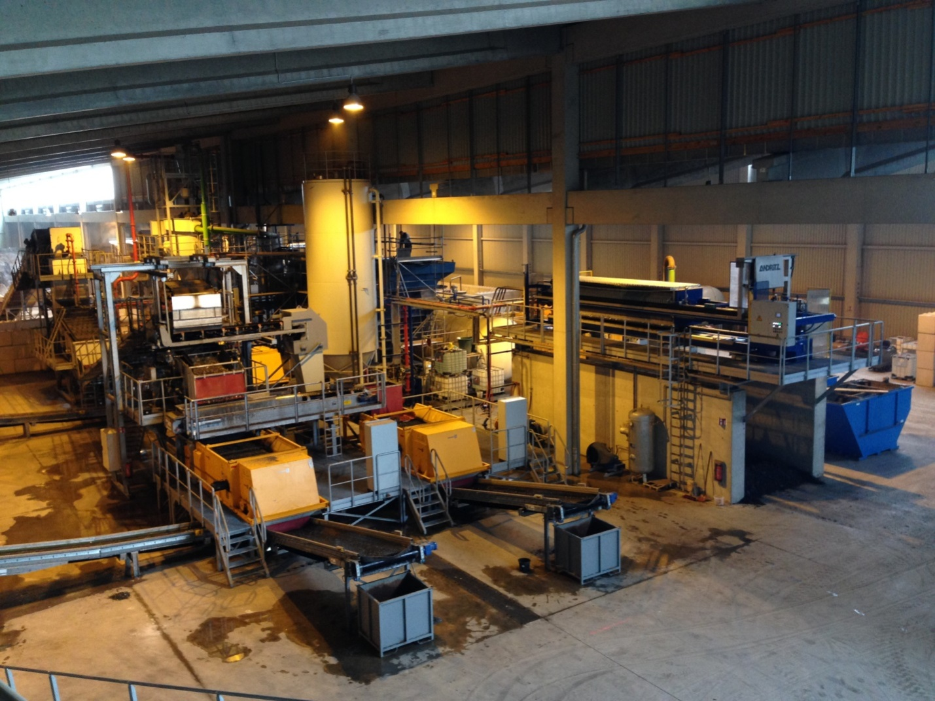
Waste streams and waste management cycles| Sofia, 01.10.2013 | Page 50
Wet preparation

Slide 51
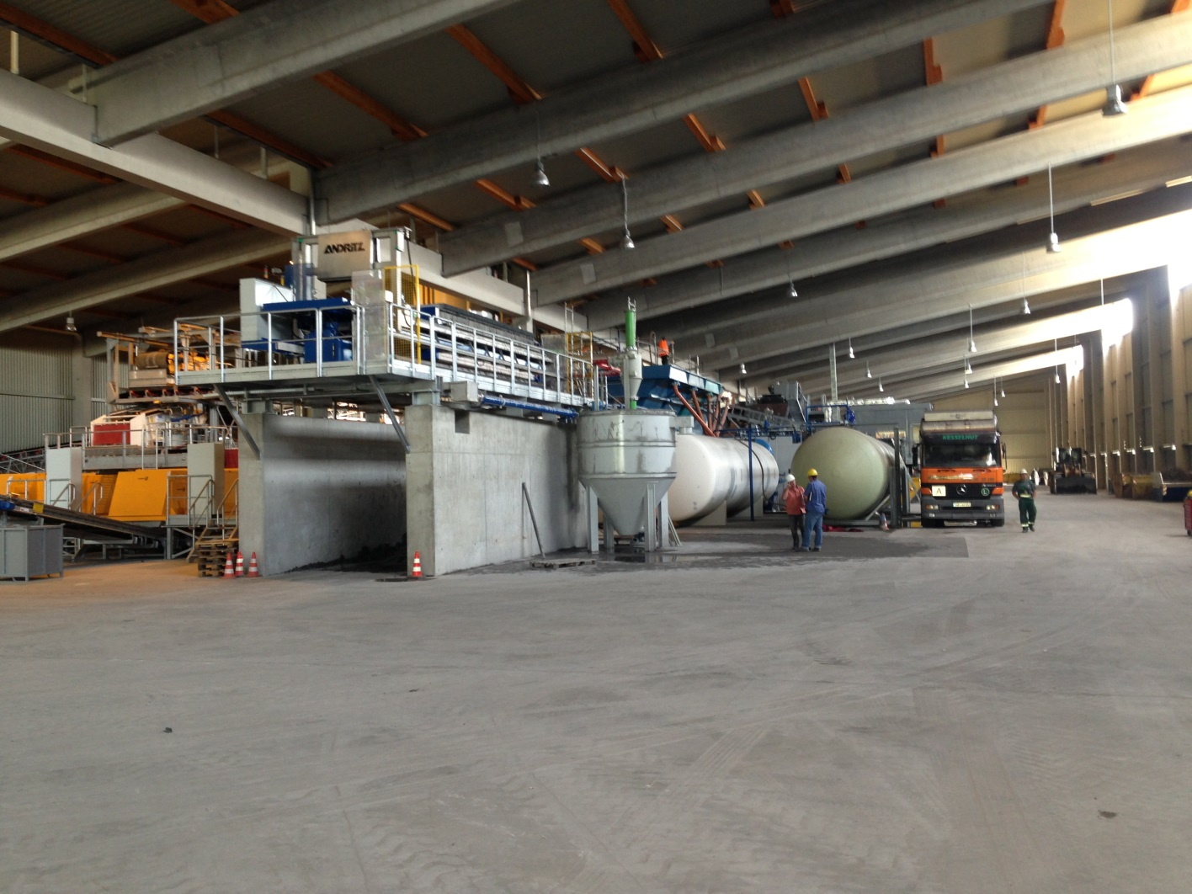
Waste streams and waste management cycles| Sofia, 01.10.2013 | Page 51
Wet preparation
and chamber
filter press

Slide 52
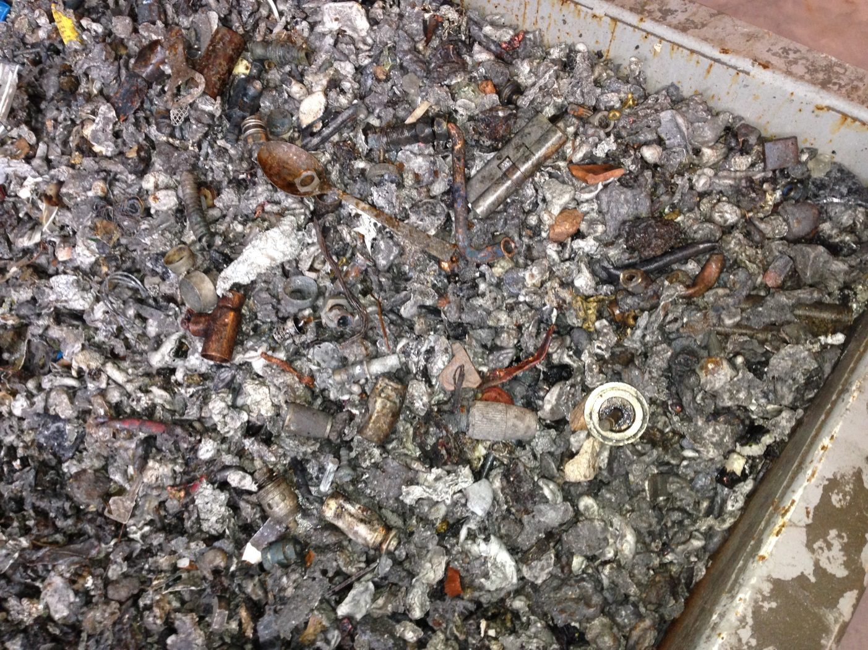
Waste streams and waste management cycles| Sofia, 01.10.2013 | Page 52
Wet separated
non-ferrous
metals

Slide 53
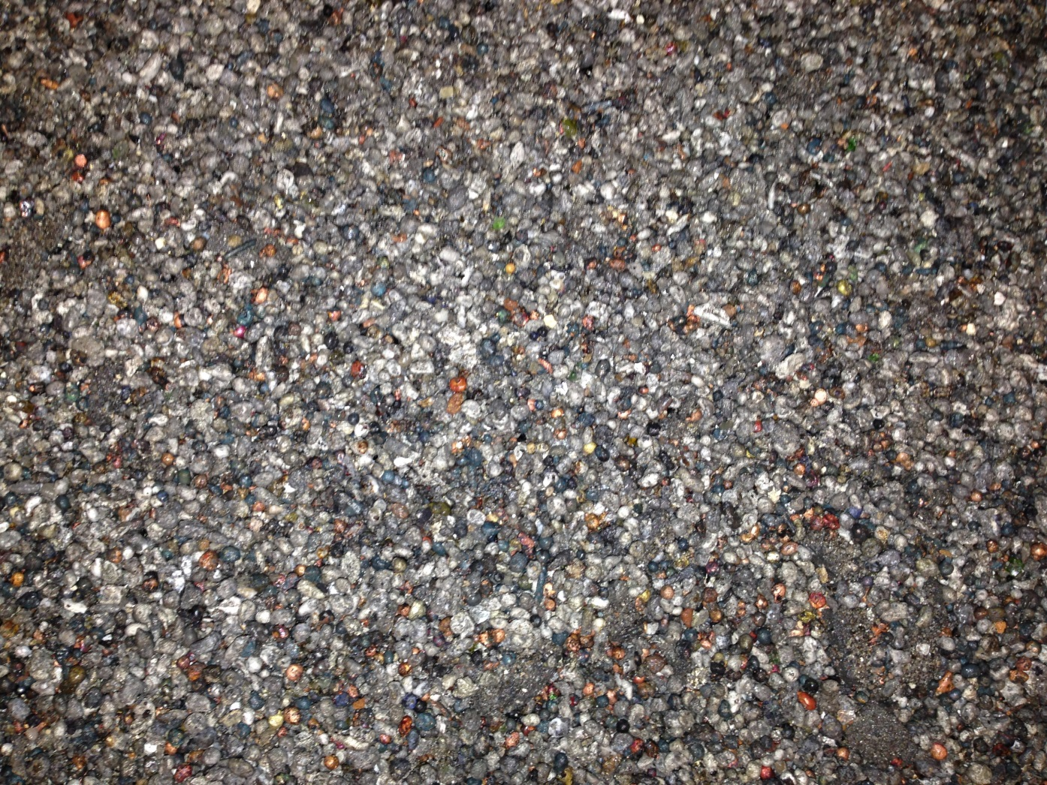
Waste streams and waste management cycles| Sofia, 01.10.2013 | Page 53
Wet separated
non-ferrous
metals
(small)

Slide 54
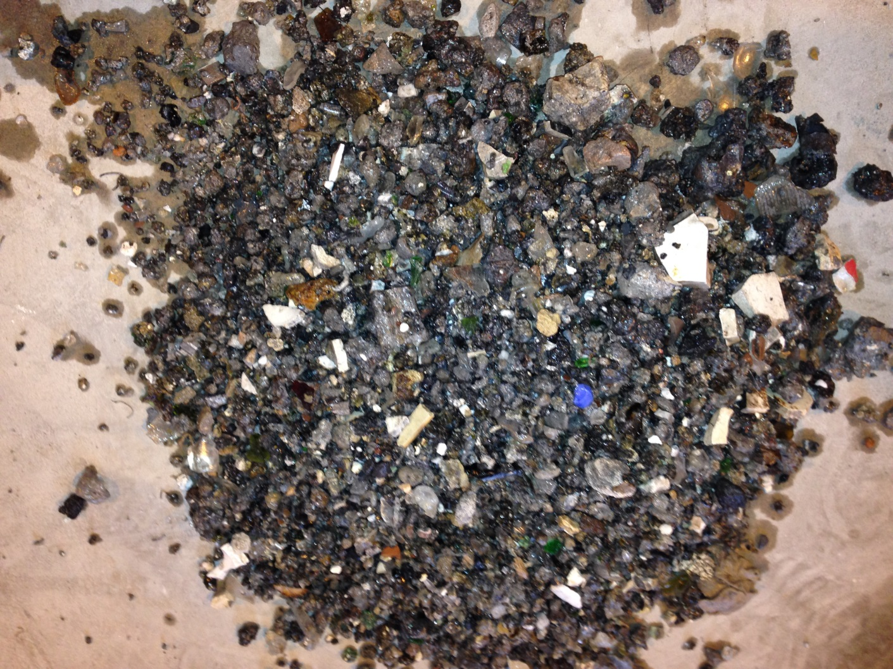
Waste streams and waste management cycles| Sofia, 01.10.2013 | Page 54
Mineral grain
(gravel) after
wet separation

Slide 55
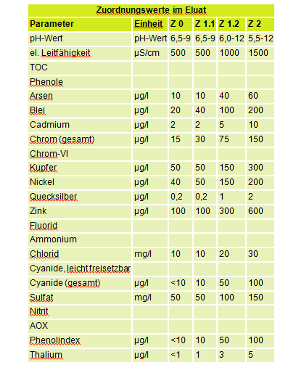
Waste streams and waste management cycles| Sofia, 01.10.2013 | Page 55
4.8 Criteria for using precessed slag
Assignment criteria for soil after
Technical rules No. 20 of the National Working Group on Waste (LAGA)
5 Categories:
Z0 unrestricted usage
Z1 restricted open emplacement in
technical construction, class-divided into
Z1.1 and Z1.2
Z2 restricted emplacement in technical
construction with defined measure of
safety
Z3 landfill class I
Z4 landfill class II
Z5 hazardous waste landfill

Slide 56
Waste streams and waste management cycles| Sofia, 01.10.2013 | Page 56
Thank you for listening.

Slide 57
Contact
Industrie- und Handelskammer Magdeburg
^{Dr. Jochen Zeiger}
Alter Markt 8 | 39104 Magdeburg
^{Telefon: 0391 5693-152}
^{Fax: 0391 5693 333 152}
E-Mail: zeiger@magdeburg.ihk.de
^{www.magdeburg.ihk.de}

